Slide 1
Telephone Company Database Project
Presented by:
1. Meron Tesfay ……………………610538 2. Mikias Ghebremariam …………....109364 3. Saron Tadesse ……………….…610585 4. Zelalem Zergaw ………………..109695

Slide 2
Objectives
To reduce the number of manual steps required by existing system.
Our system makes it easier to use and reduces the chances of error.

Slide 3
Design steps
1. ER Diagram
2. Logical Data Design
3. Creating Tables and
4.importing data into SQL Server
5. Stored Procedures
6. Additional Features
7. Demonstration
8. Question and Answer Session

Slide 4
ER DIAGRAM
Entities that are identified
1. Customer:
2. Service:
3. Sales Representative
4. Calls:
5. Calling Code
6. Rate

Slide 5
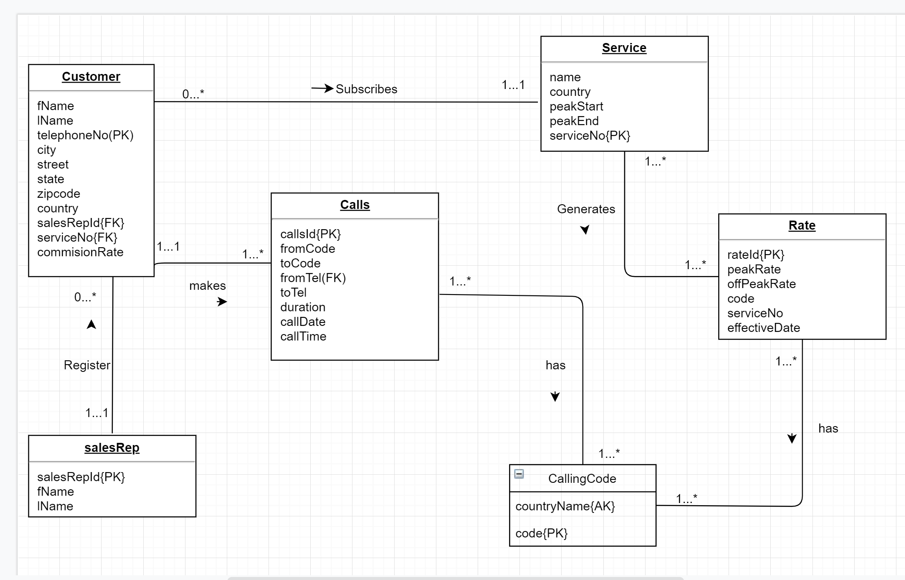
Er diagram

Slide 6
Logical design
Customer (fName, lName, telephoneNo, city, street, state, zipCode, country, salesRepID, serviceNo, commissionRate)
Primary key: telephoneNo
Foreign key: salesRepID Reference SalesRep (SalesRepID)
Foreign key: serviceNo Reference Service (SeriveNo)
SalesRep (salesRepID, fName, lName)
Primary key: salesRepID
Service (name, country, peakStart, peakEnd, serviceNo)
Primary key: serviceNo
Call (callsID, fromCode, toCode, fromTel, toTel, duration, callDate, callTime)
Primary key: (callsID)
Foreign key: fromCode Reference CallingCode (code)
Foreign key: toCode Reference CallingCode (code)
Foreign key: fromTel Reference Customer (fromTel)
CallingCode (code, countryName)
Primary key: code
Alternative Key: countryName
Rate (rateID, peakRate, offPeakRate, code, serviceNo, effectiveDate)
Primary key: (rateID)
Foreign key: serviceNo Reference Service (serviceNo)
Foreign key: code Reference CallingCode (code)

Slide 7
Stored procedures
Import rate and export rate
Import and adding new customer
Generate monthly bill etc.

Slide 8
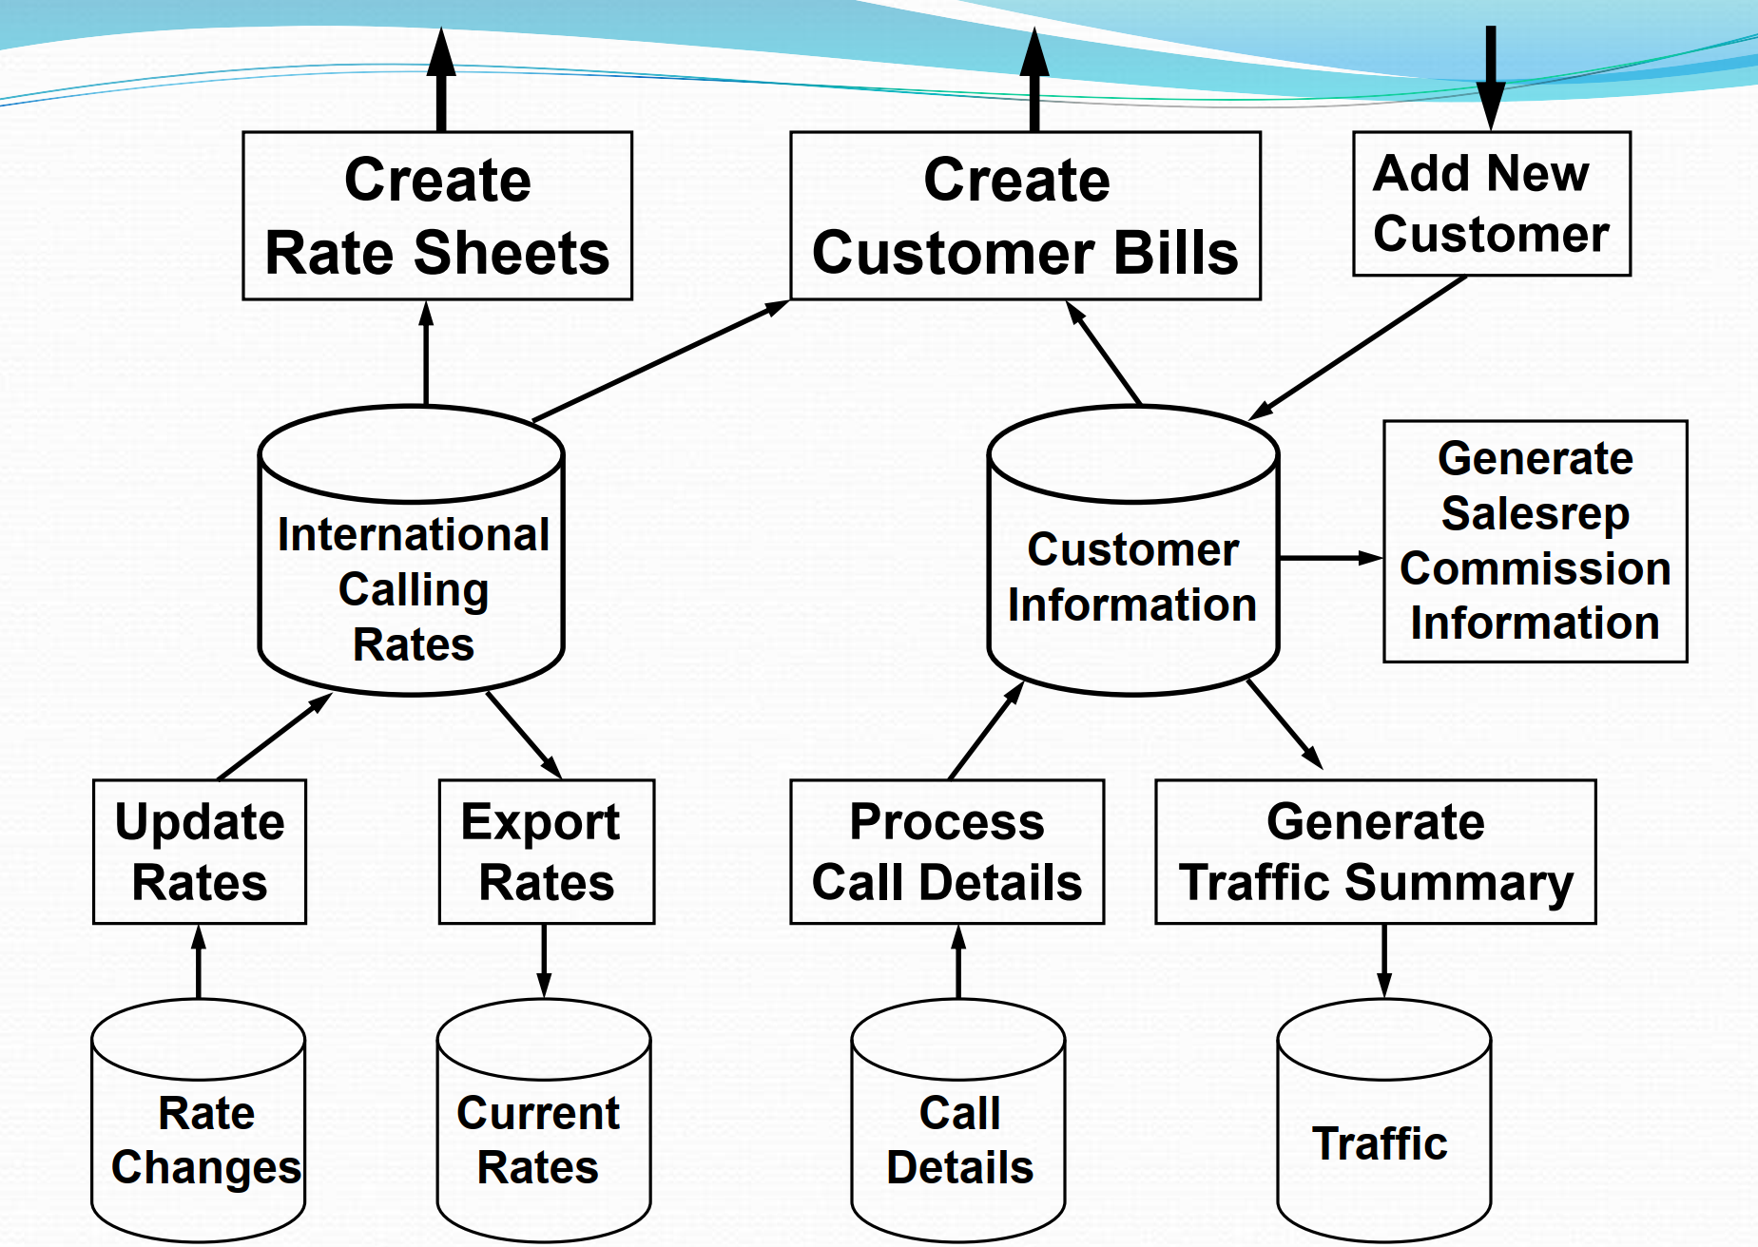
Functionalities

Slide 9
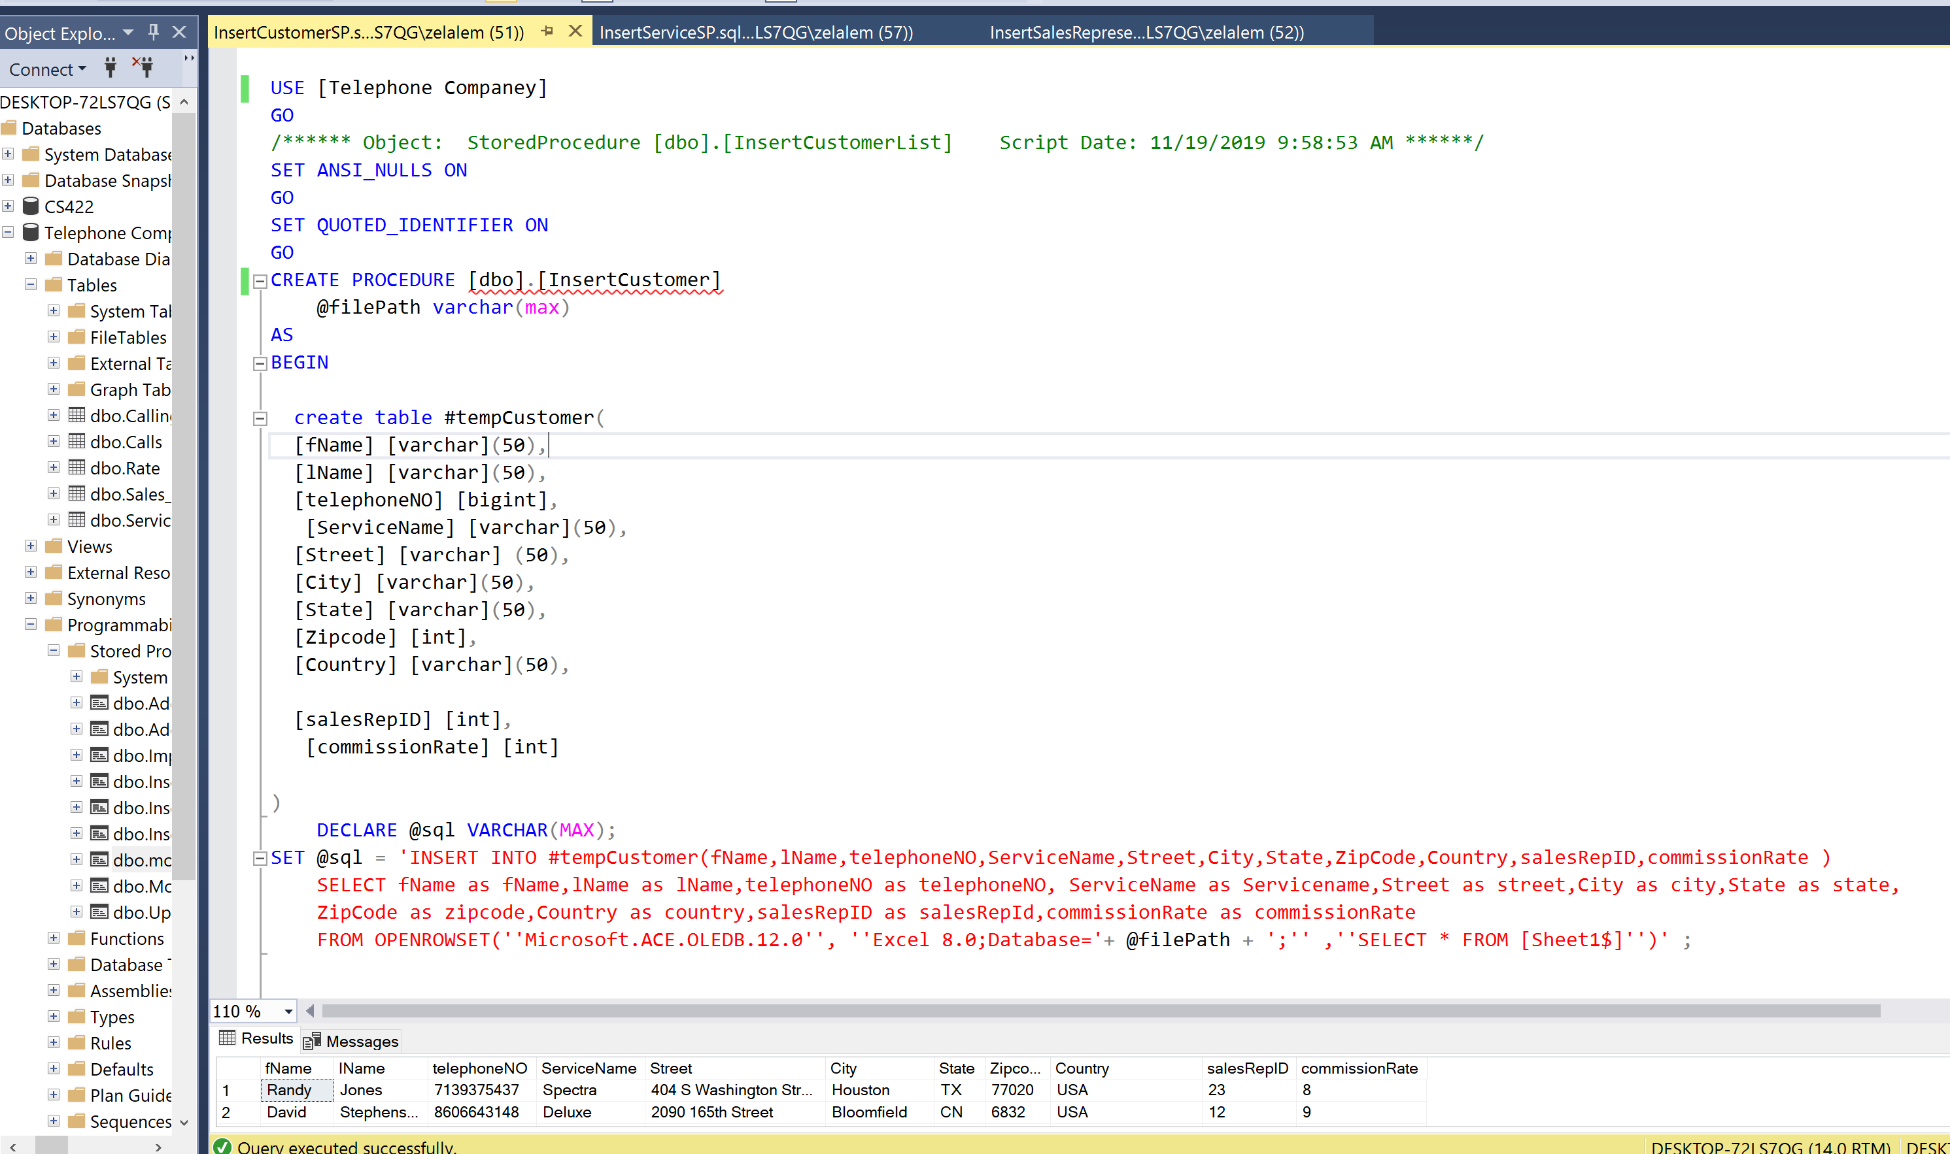
Insert customer

Slide 10
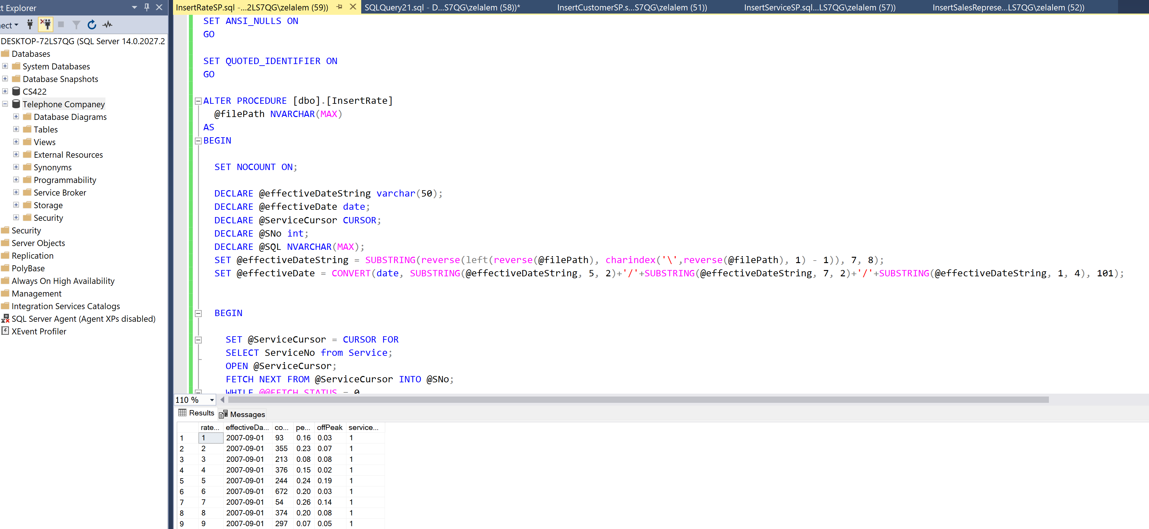
Insert RATE

Slide 11
Importing data into SQL Server
Using Microsoft.ACE.OLDEB.12.0
Inserting Calling Code from given excel data(CallingCode.xls) into our table CallingCode in the data base.
INSERT INTO CallingCode
SELECT * FROM OPENROWSET('Microsoft.ACE.OLEDB.12.0',
'Excel 12.0;Database=C:\Users\yared\Documents\DBMS\Project\CallingCode.xls', [Sheet1$])

Slide 12
demonstration

Slide 13
Thank you!

